Slide 1

Building an E-Commerce System
Muhammed

Slide 2
In this PowerPoint
Creating the Initial Project
Creating Models
Scaffolding Models
Editing Controllers to be able to add an item to the basket
Checkout Process
Viewing Order History and Tracking Options
Creating a Dashboard
Linking External CSS
Authorisation
Seed Data
Gmail Login Integration

Slide 3
Creating the Initial Project

Slide 4
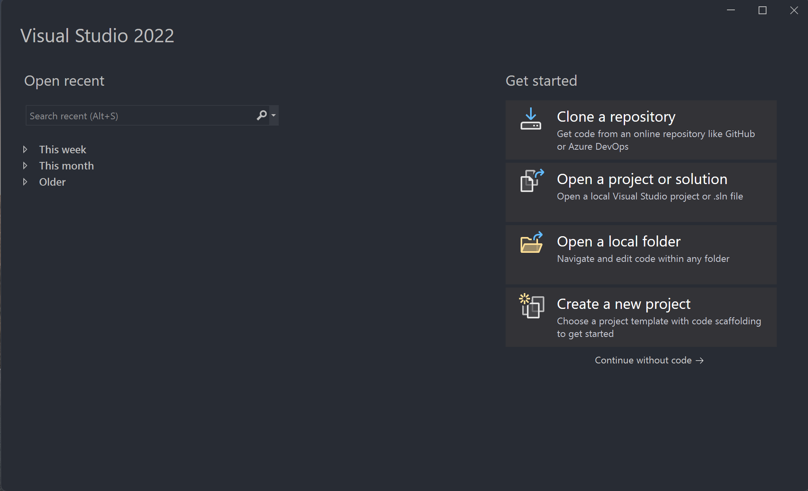
Open Visual Studio 2022 and select Create a new Project

Slide 5
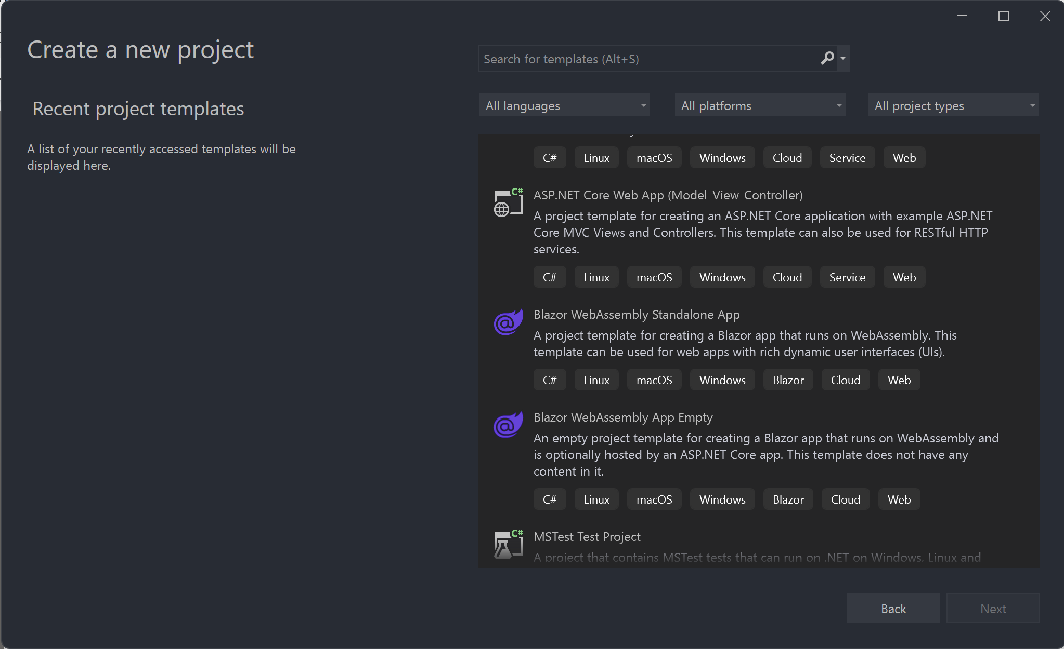
Select the ASP.NET Core Web App (Model-View-Controller) C#

Slide 6
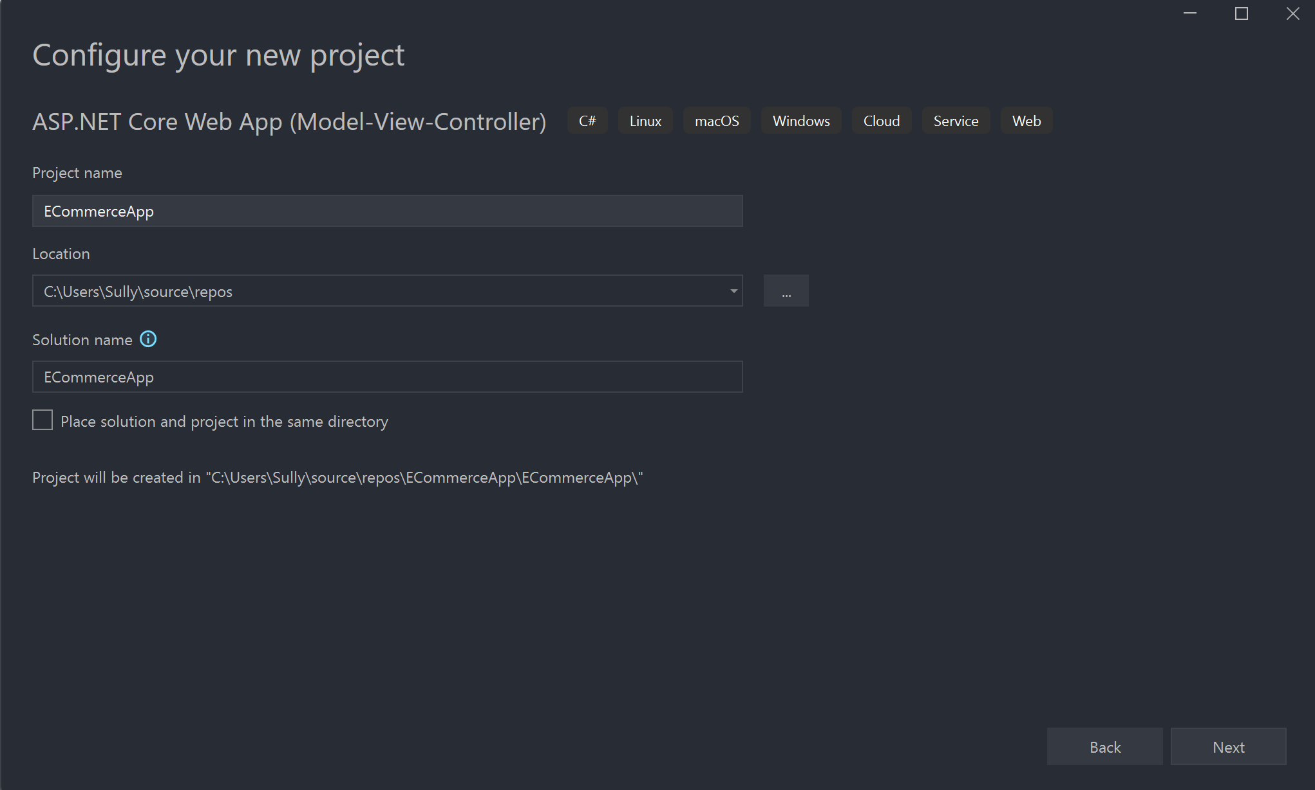
Name the Project

Slide 7
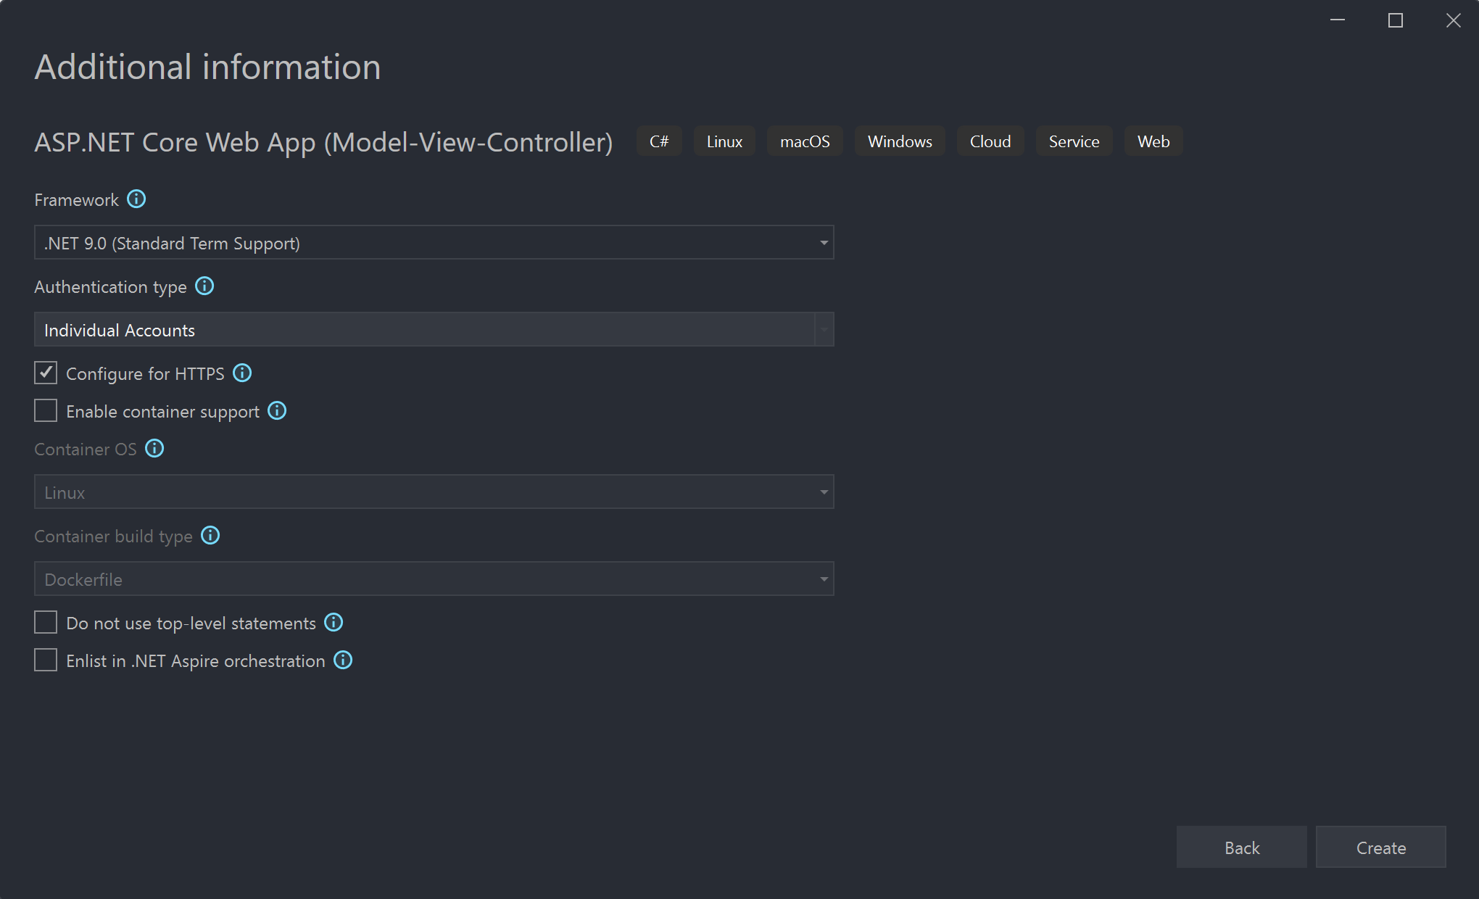
Select .NET 9.O and then Individual Accounts for Authentication Type

Slide 8
Project Created

Slide 9
Installing the Packages (Has to be 9.0.12)

Slide 10
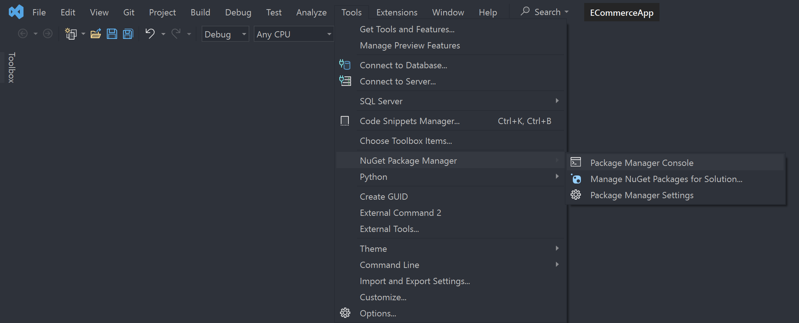
Open the Package Manager Console

Slide 11
Install the following Packages
Install-Package Microsoft.VisualStudio.Web.CodeGeneration.Design -Version 9.0.12
Install-Package Microsoft.EntityFrameworkCore.Design -Version 9.0.12
Install-Package Microsoft.EntityFrameworkCore.SqlServer -Version 9.0.12

Slide 12

Add-Migration Update-Database

Slide 13
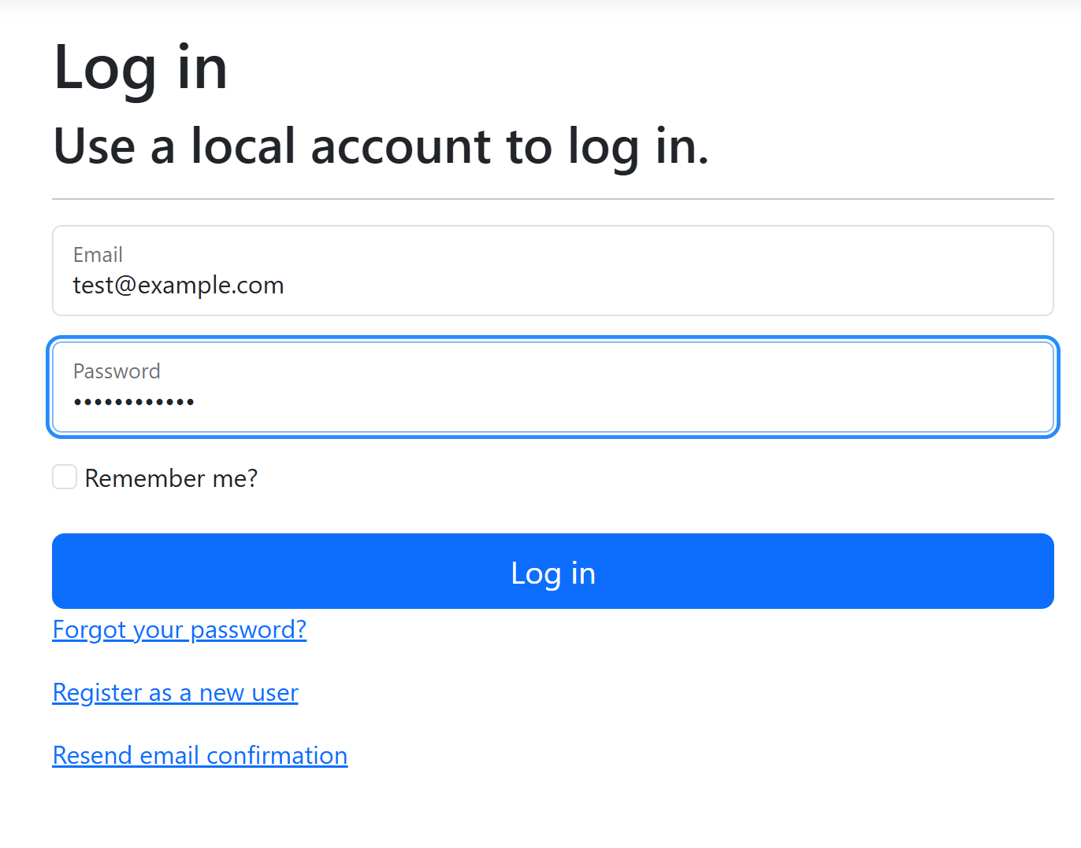

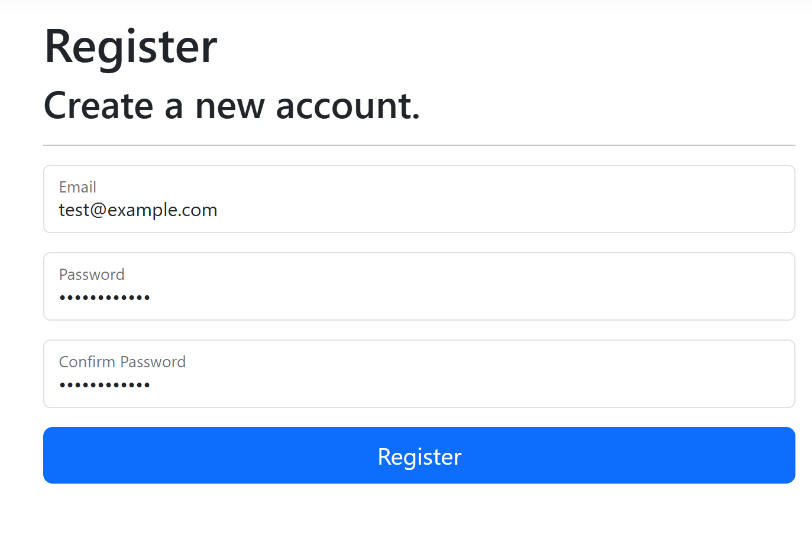
Run the Application with HTTP and test the login and register system
Register a new User and login with it

Slide 14
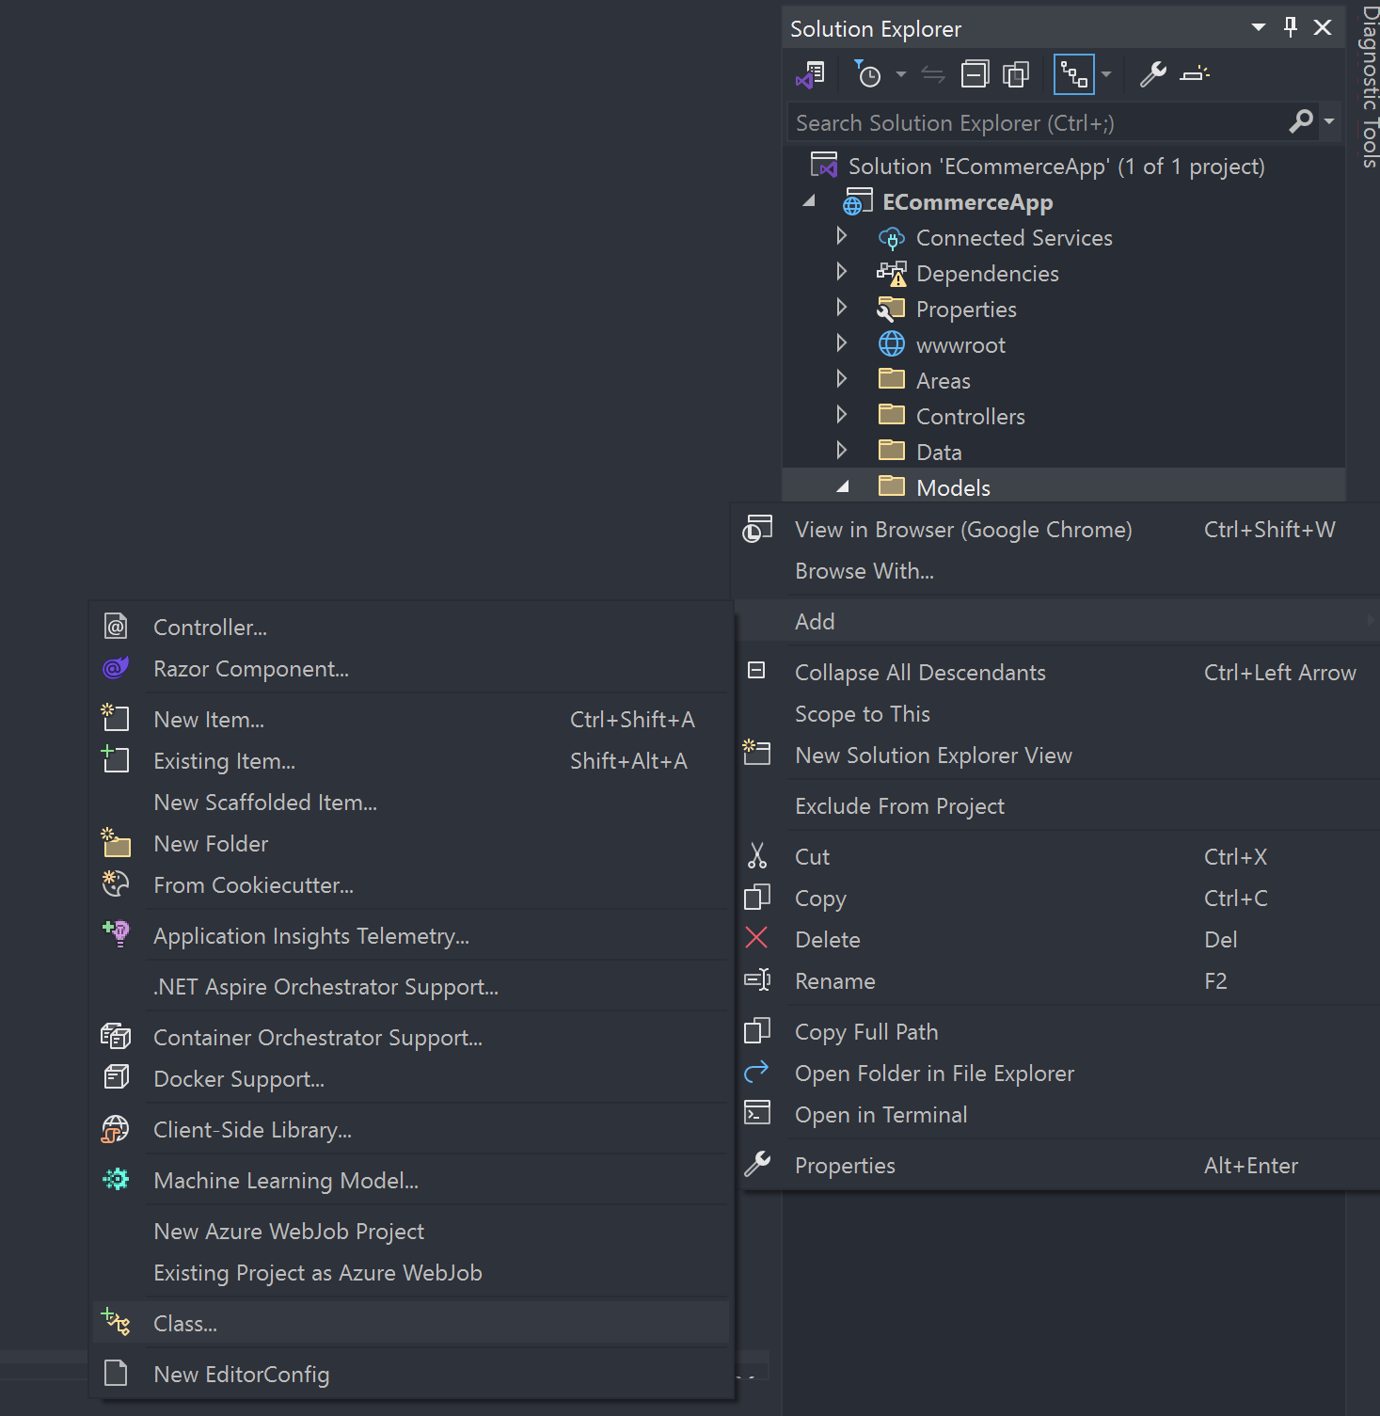
Time to add the models

Slide 15
These are the models I am using (May not be the same for you)
Basket
BasketProducts
OrderProducts
Orders
Products
Suppliers

Slide 16
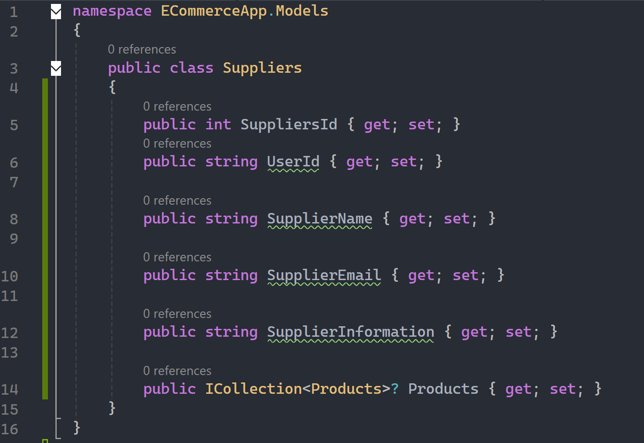
Suppliers (Producers) Model

Slide 17
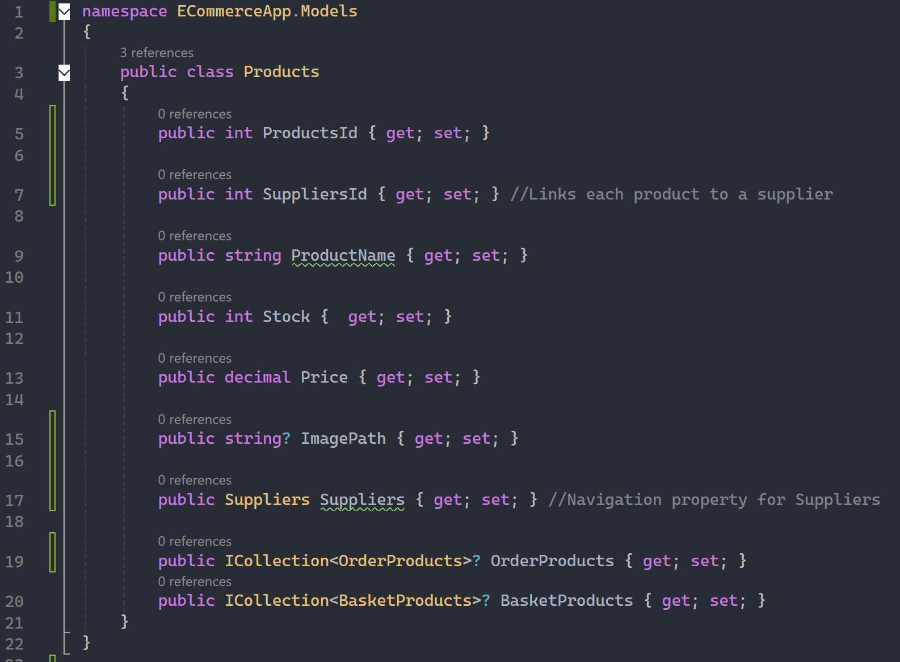
Products Model

Slide 18
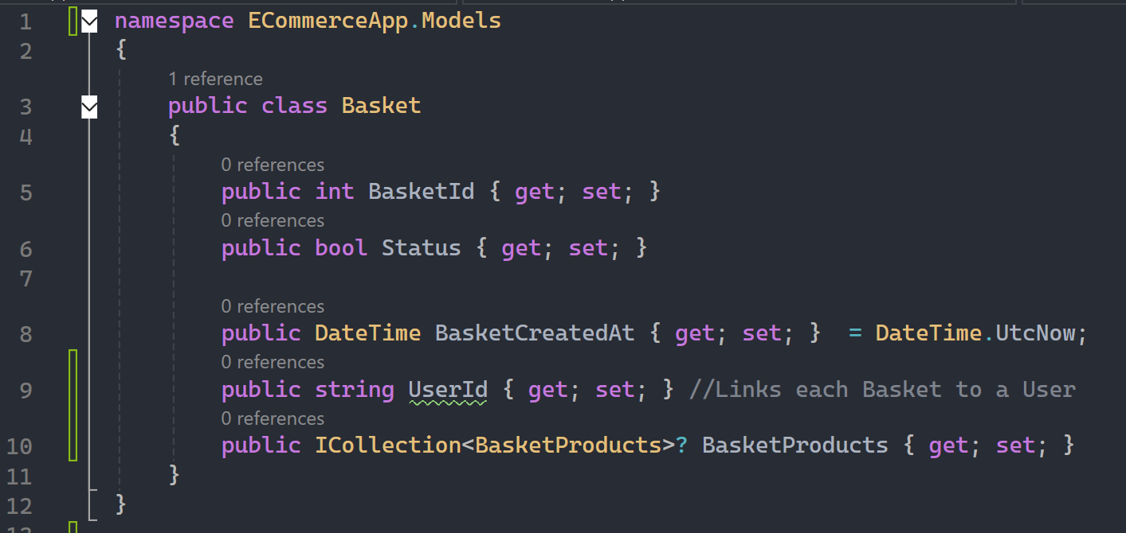
Basket Model

Slide 19
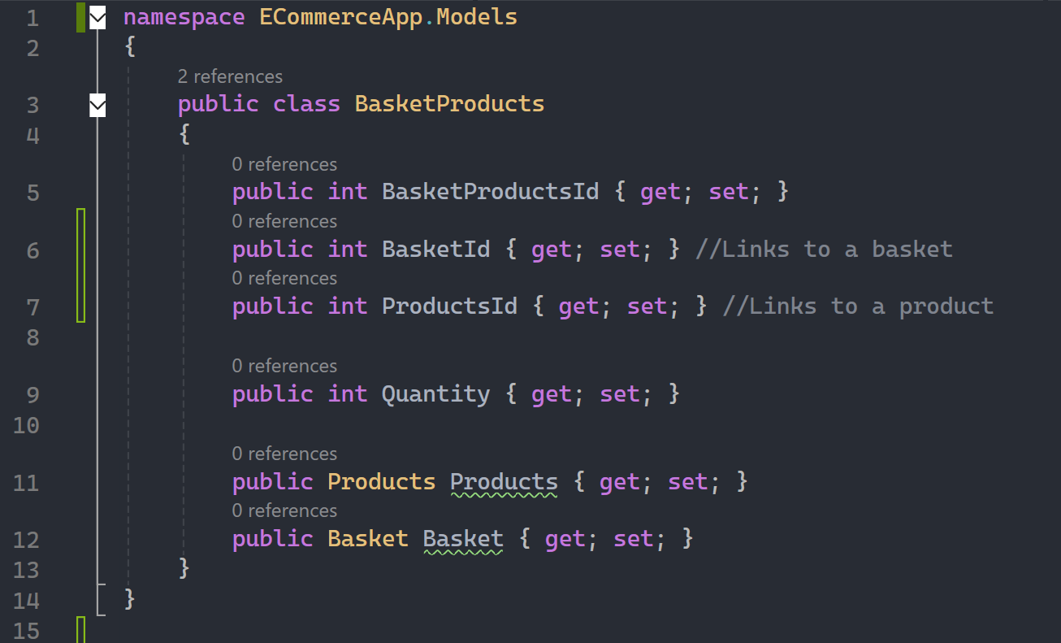
BasketProducts Model

Slide 20
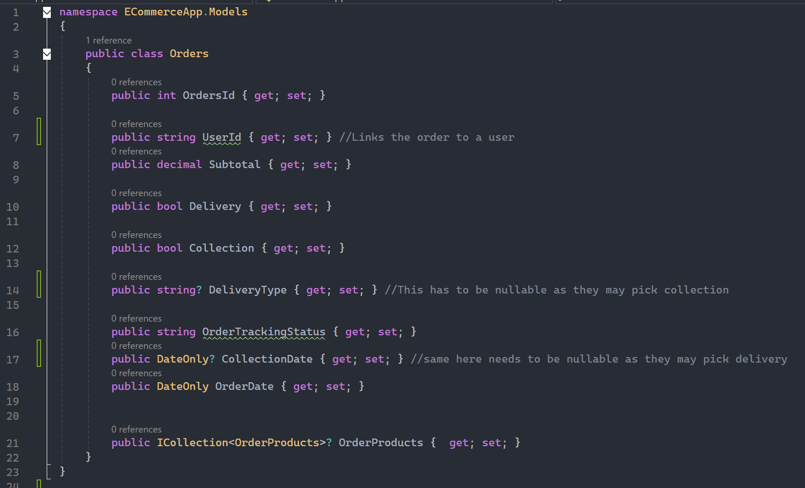
Orders Model

Slide 21
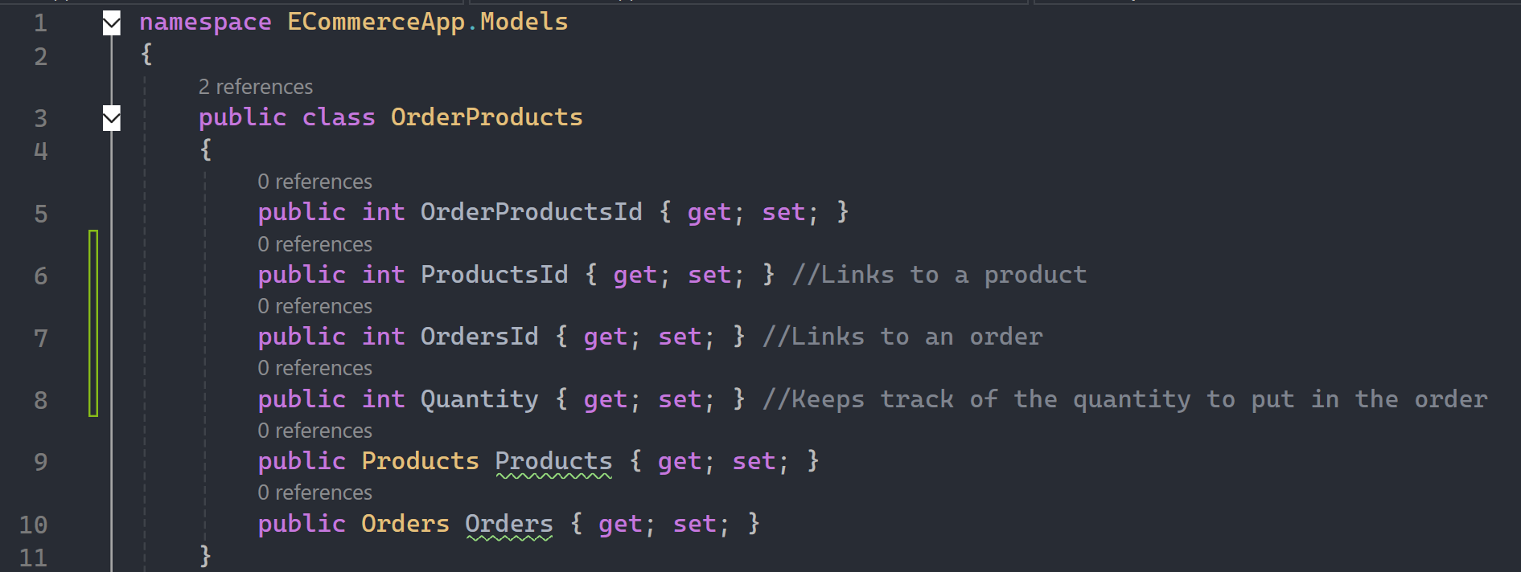
OrderProducts Model

Slide 22
Now we scaffold all the models as Controllers with Views

Slide 23
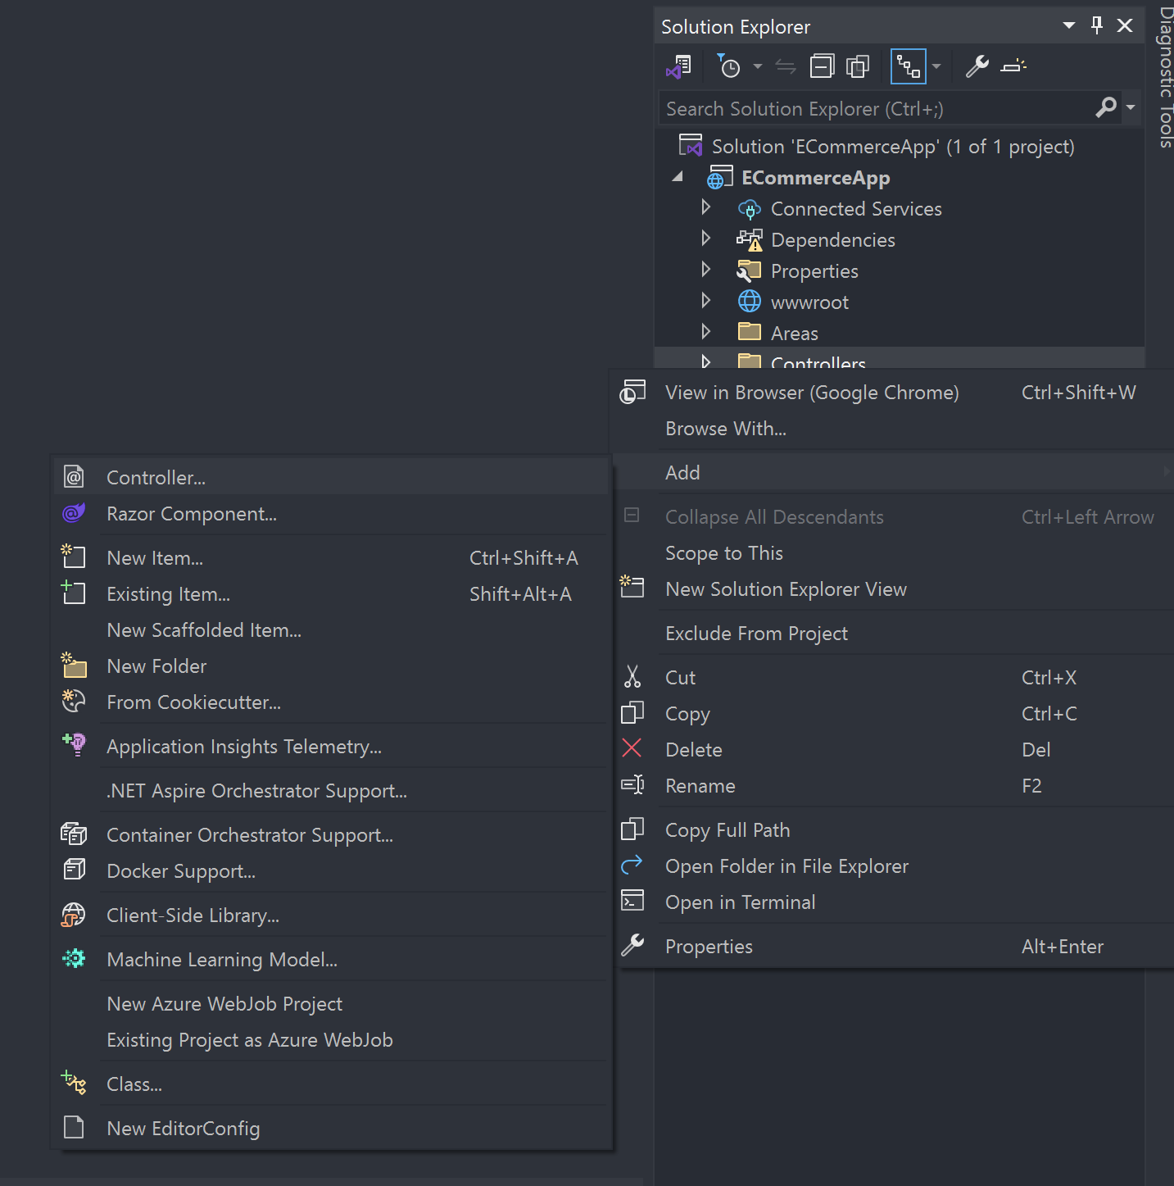
Right Click the Controllers Folder -> Add -> Controller

Slide 24
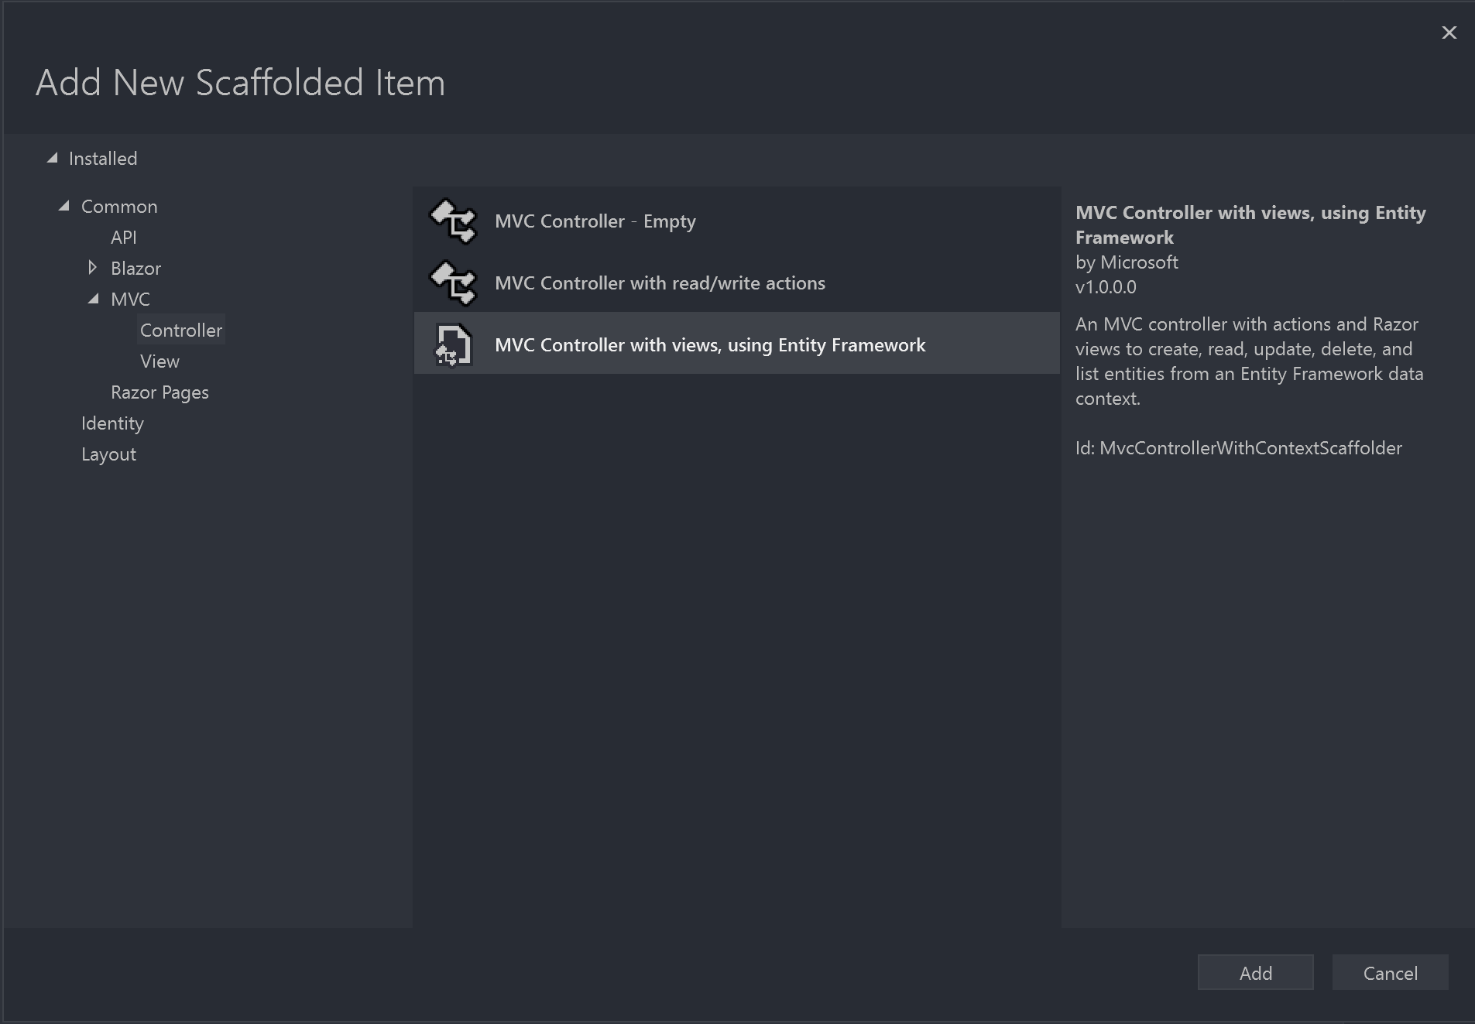
Select MVC Controller with views, using Entity Framework and Select Add

Slide 25
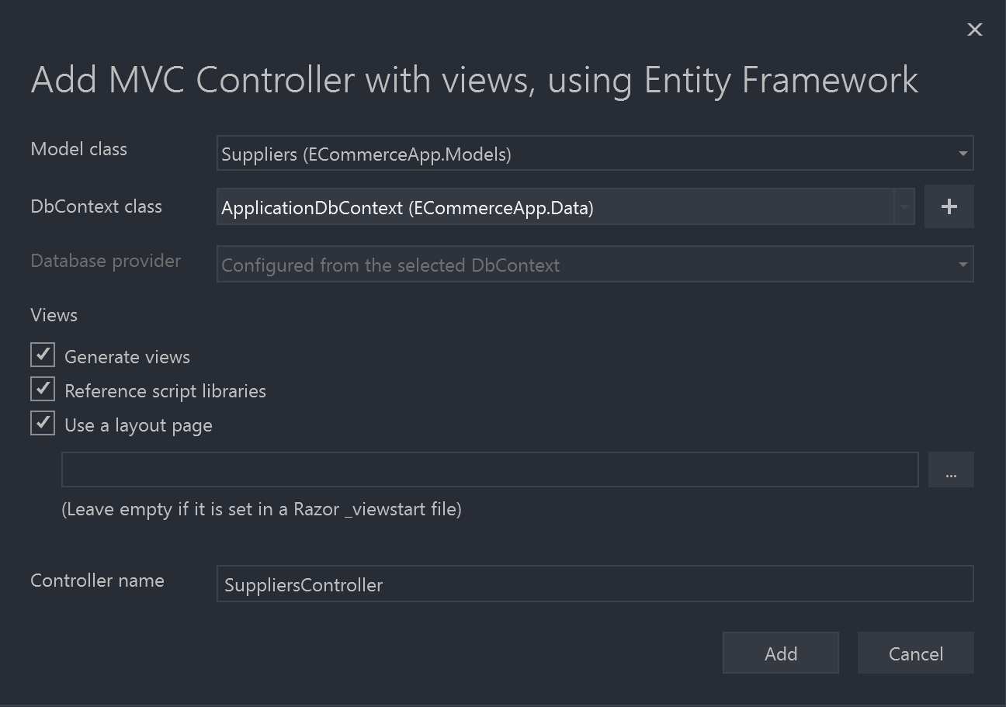
Select the first model you want to scaffold and then choose the ApplicationDbContext

Slide 26
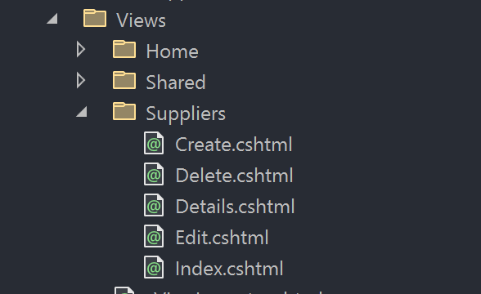
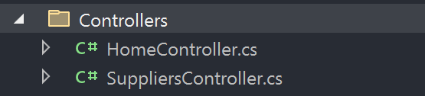
Now have that controller and the views

Slide 27
Repeat the same step with all of the models

Slide 28
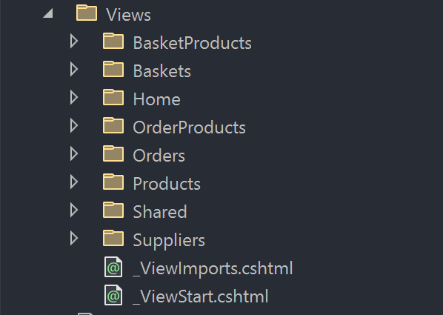
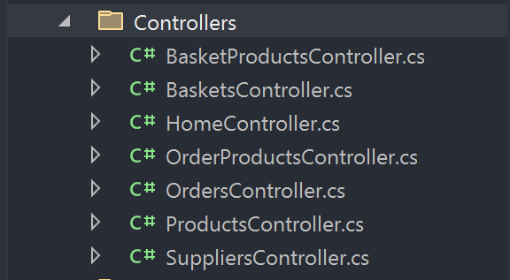
My End Result

Slide 29
Add-Migration Update-Database

Slide 30
You can test the web application and try all the end points if you want now

Slide 31
First Function is Seeding Users and Roles

Slide 32
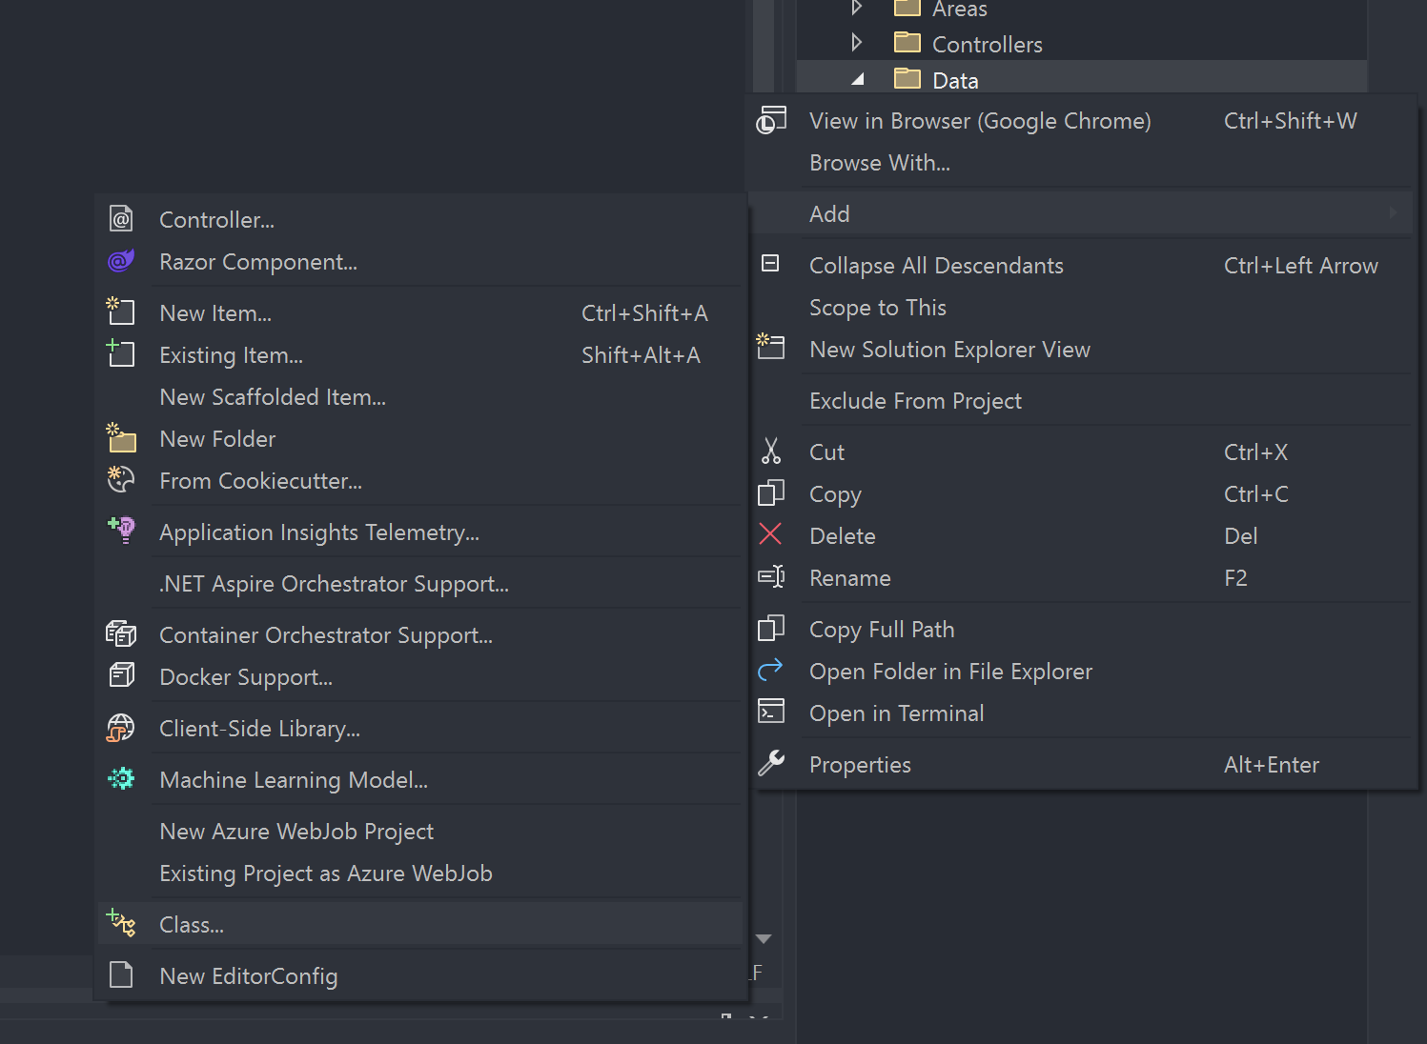
Right click the data folder and select Add -> Class

Slide 33
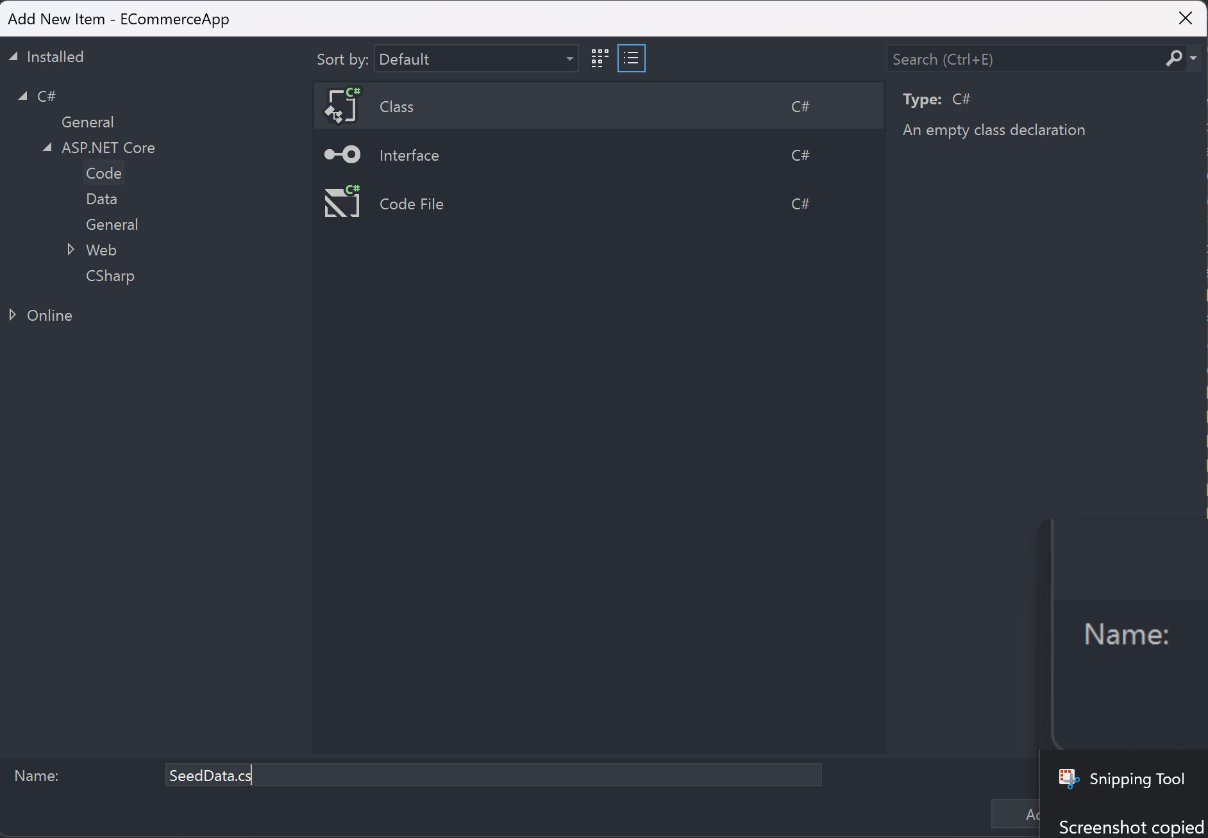
Create the new class called SeedData

Slide 34
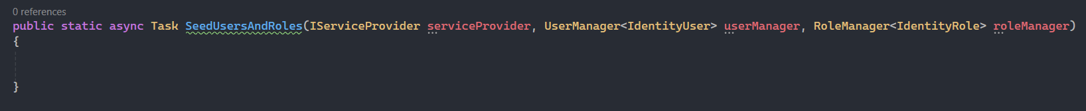
Going to create the following method called SeedUsersAndRoles

Slide 35
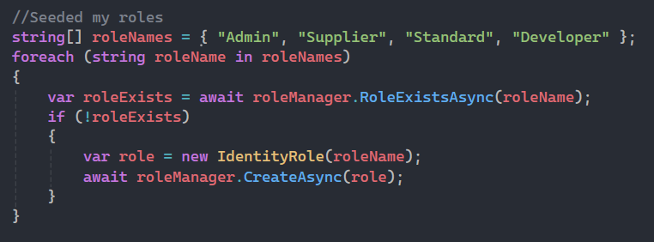
First lets add the roles ->> Inside the method we just made

Slide 36
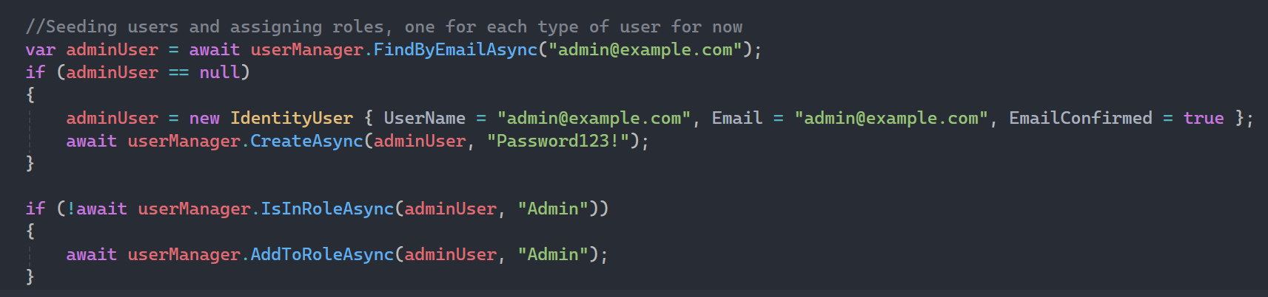
Still inside the method under what we just wrote let's create the different users

Slide 37
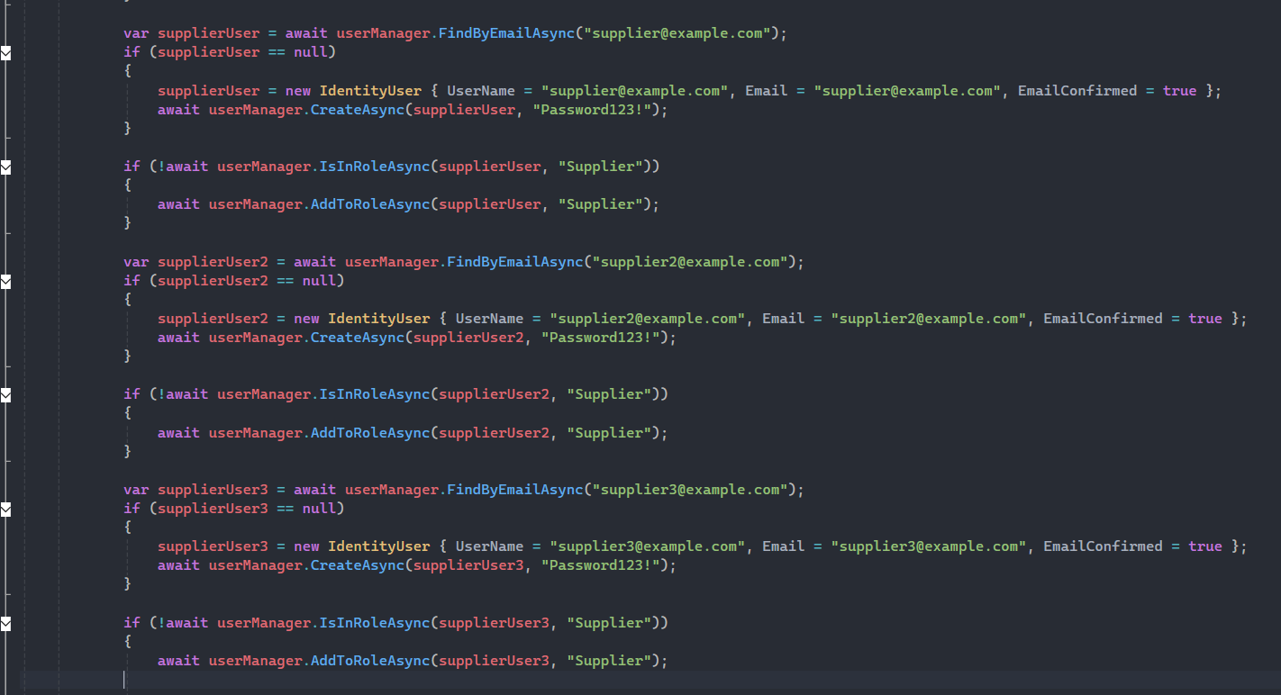
Adding the 3 supplier users for different suppliers

Slide 38
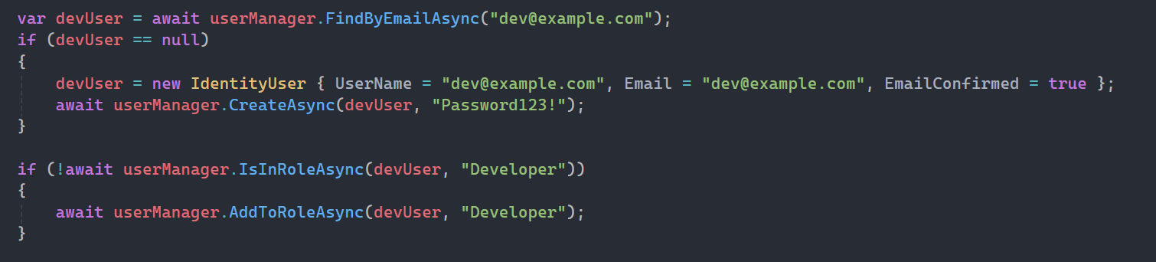
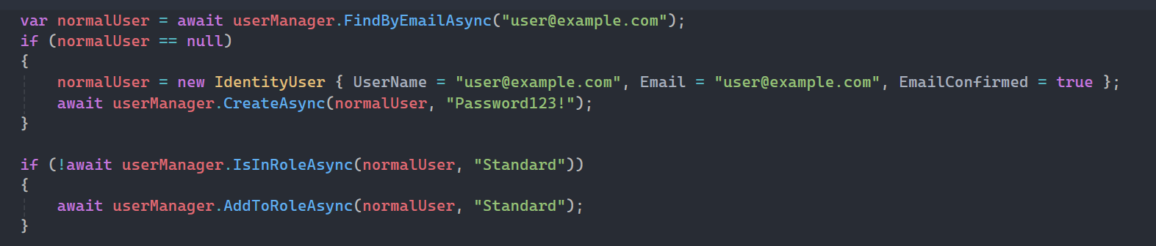
Now adding the normal and dev user

Slide 39
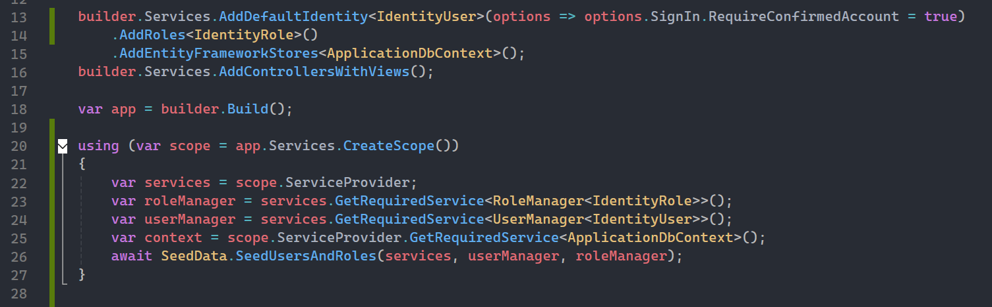
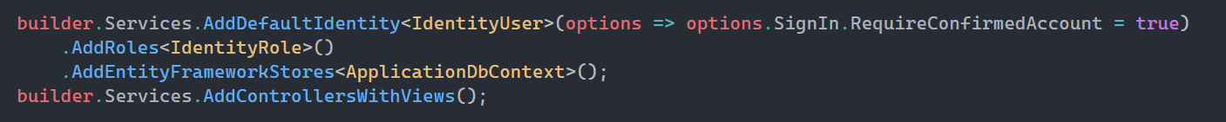
Program.cs code

Slide 40
Run the program and test logging in to each account to ensure they are working

Slide 41
Now lets seed the Suppliers as the next set of data we need

Slide 42
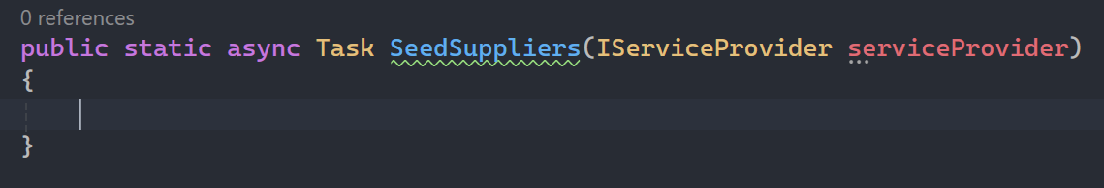
Add this method in the SeedData.cs file under the SeedUsersAndRoles method

Slide 43
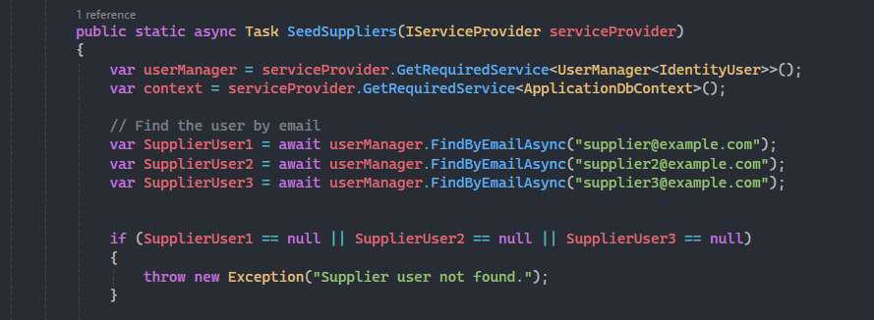
Write the following code to find the supplier you want to link

Slide 44
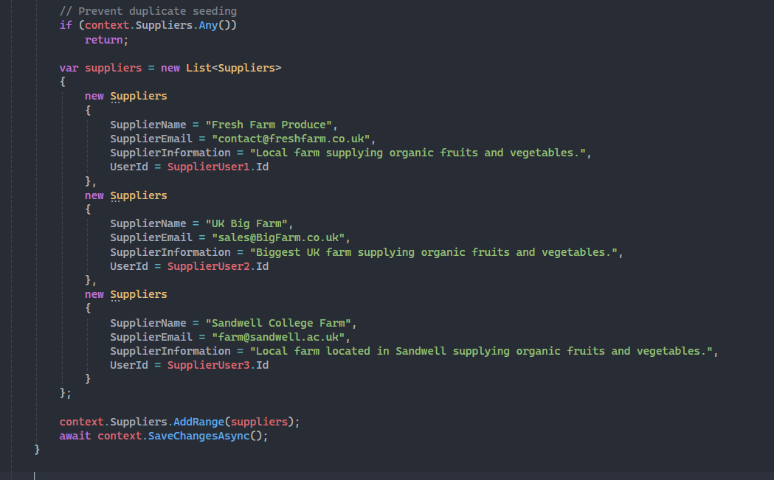
Now to seed the suppliers

Slide 45
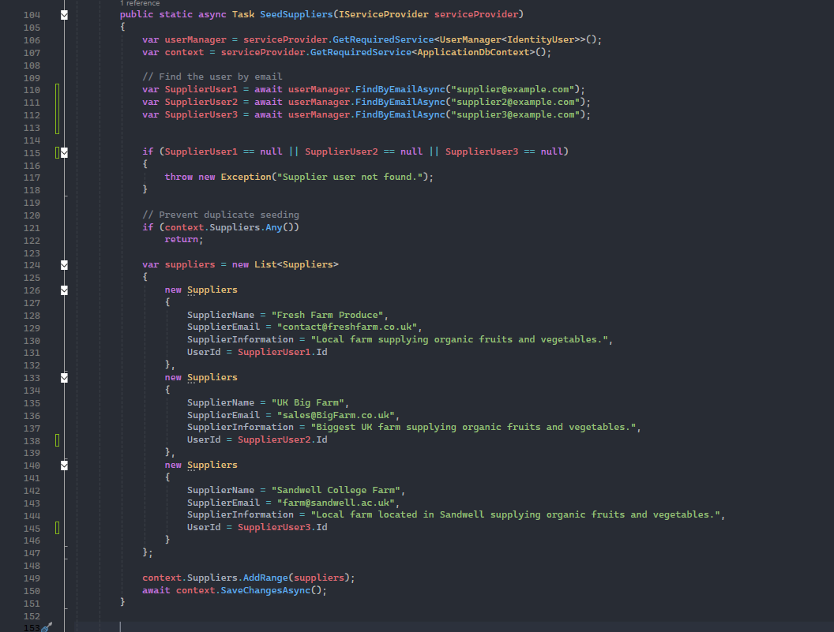
Full Function

Slide 46
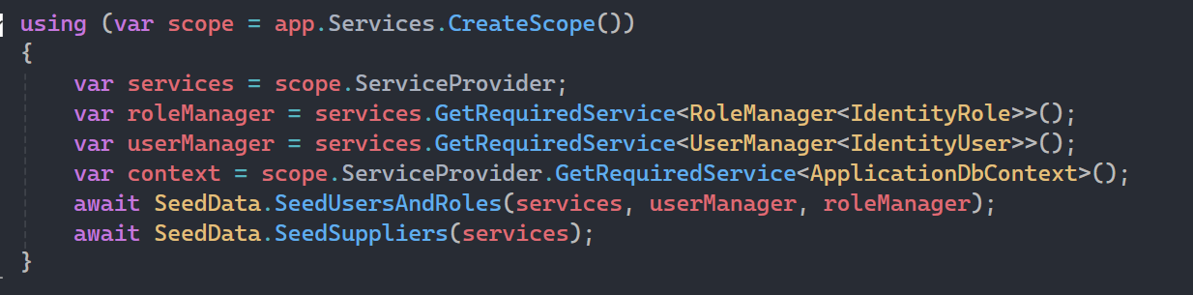
Edit the Program.cs Code to call this function now

Slide 47
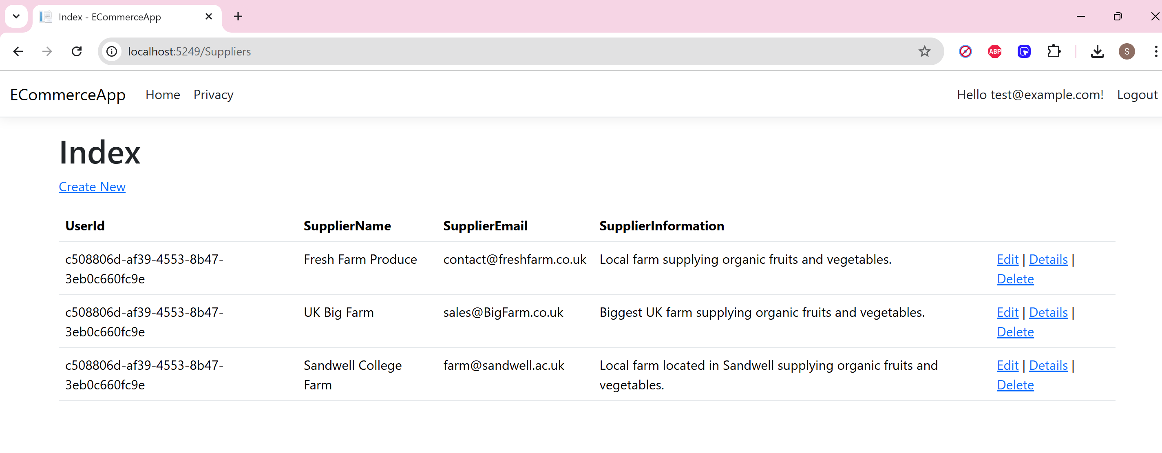
Run the Program and test the homepage for Suppliers to ensure that is working

Slide 48
Time to Seed the Products next

Slide 49
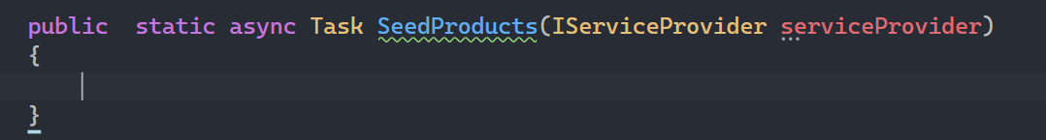
Create the method under the seedSuppliers method

Slide 50
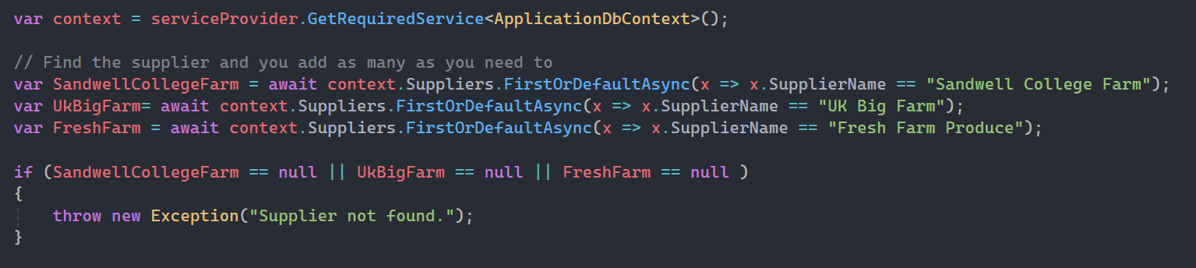
Inside this method find the suppliers which we are going to link to the products

Slide 51
Now before we can continue seeding products we need to find the images and save them to the right folder

Slide 52
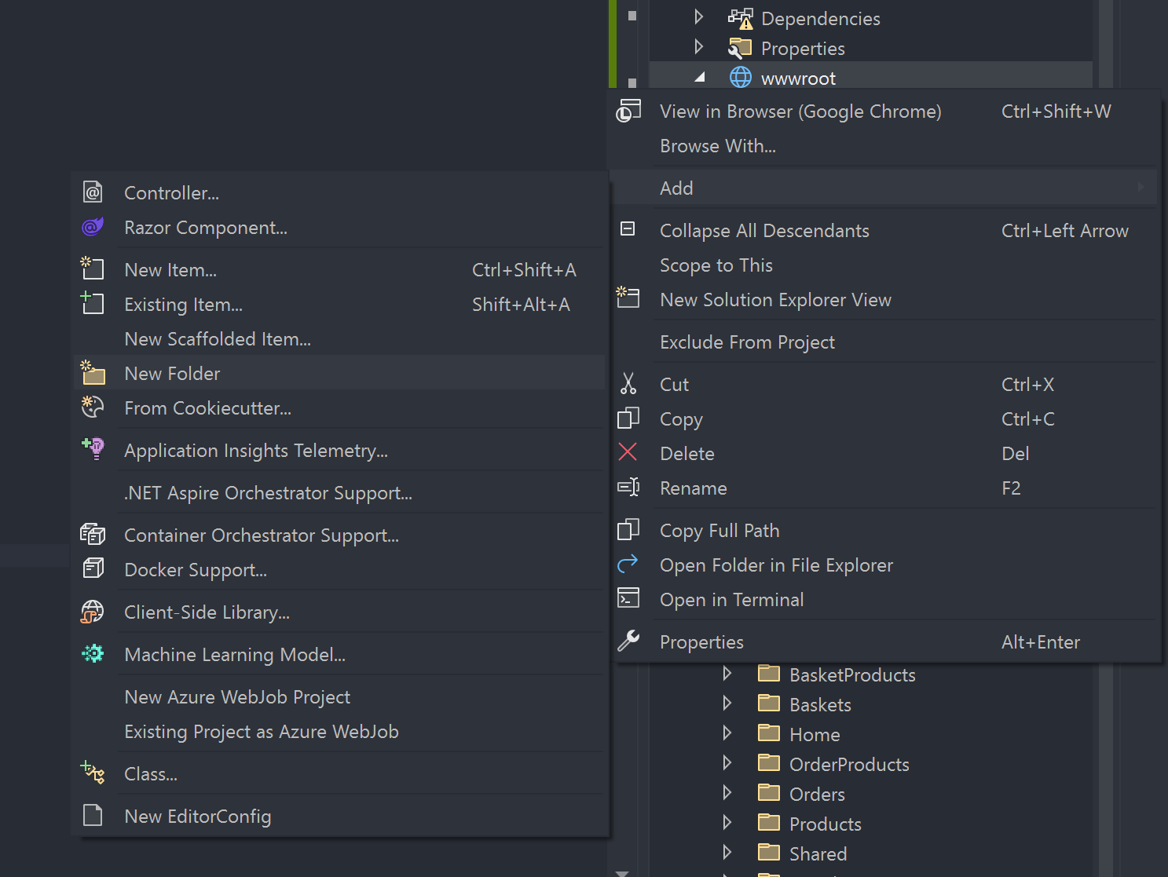
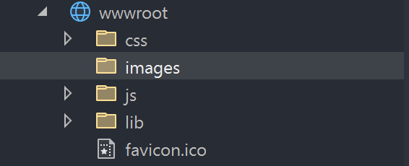
Right click the wwwroot folder and create a new folder called images

Slide 53
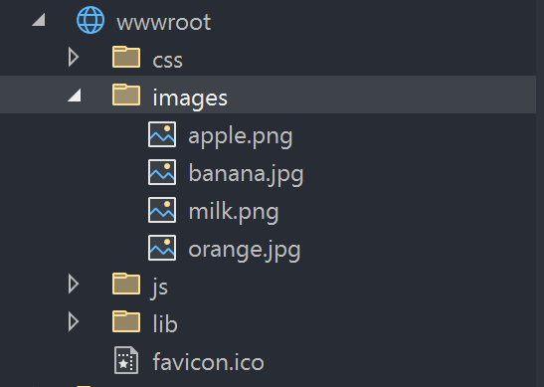
Find images for your products as long as they are png's or jpeg's

Slide 54
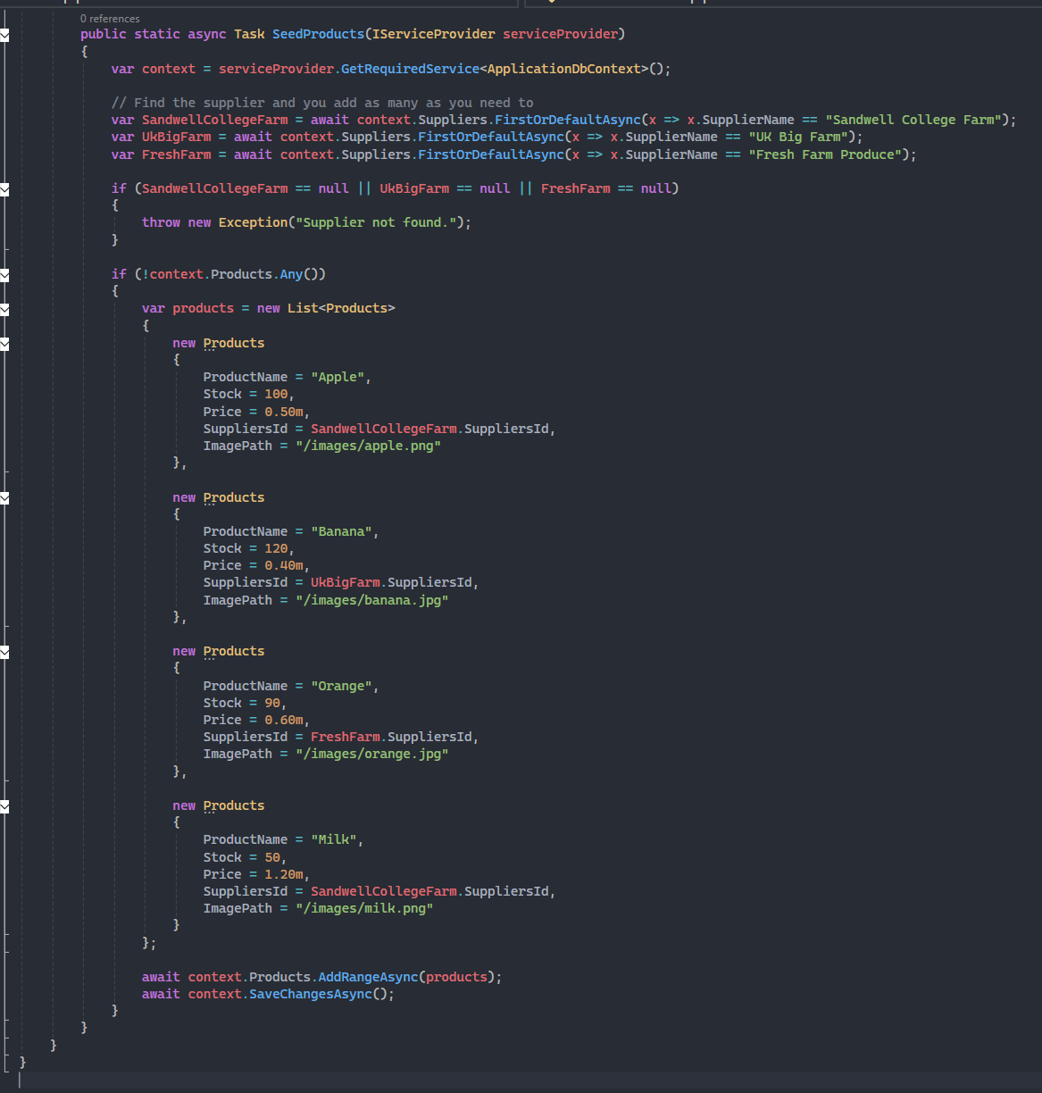
Now write your Seed Products code under the section where we found the suppliers

Slide 55
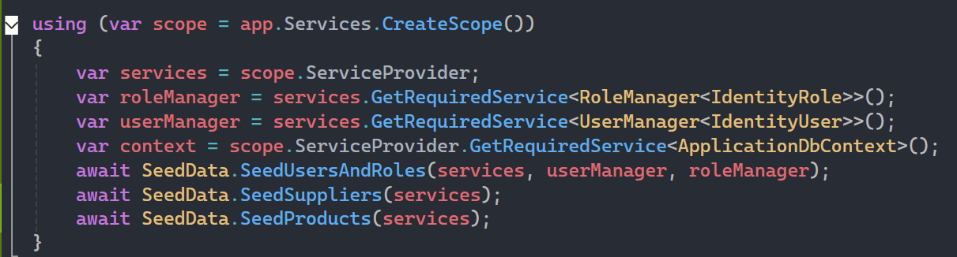
Add to Program.cs

Slide 56
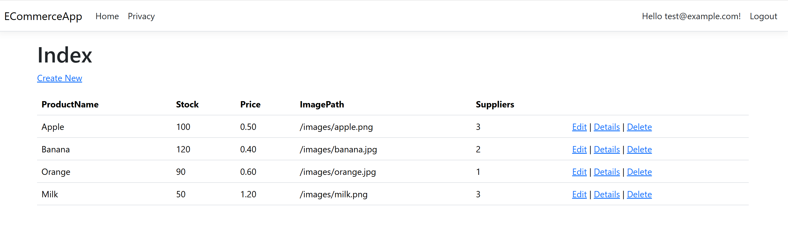
Run the web application and test the products page to see if everything is there

Slide 57
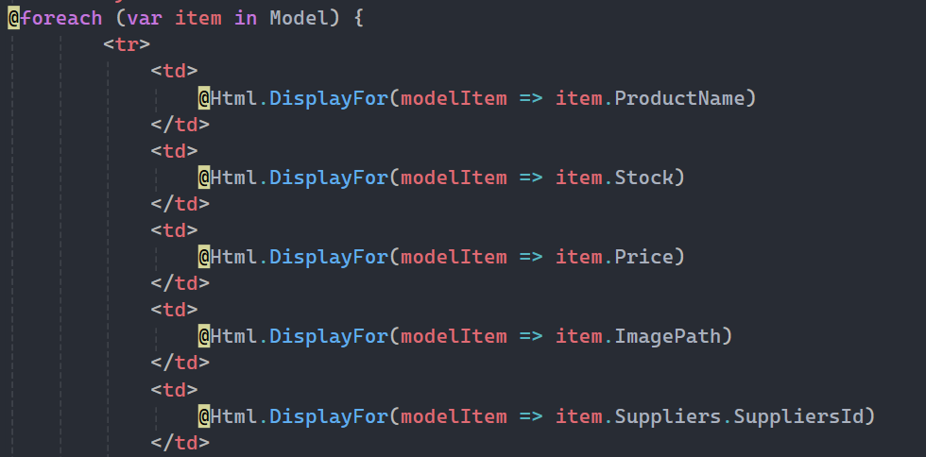
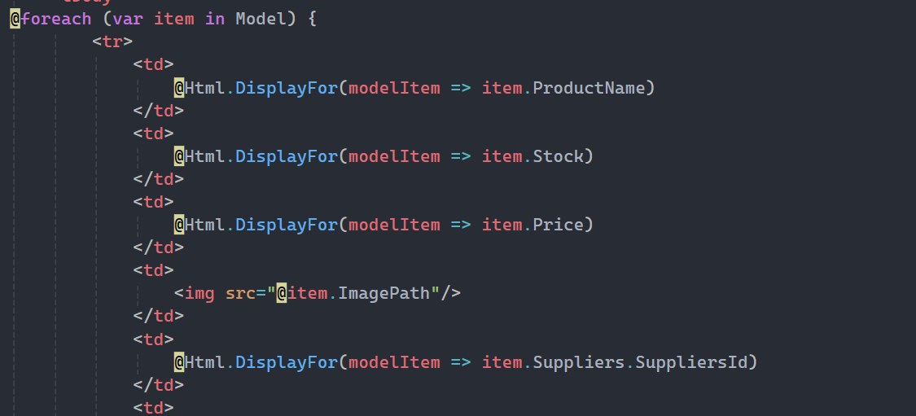
Images don't work because they are not inside of an img tag can fix this later. If you implement this now images will be oddly sized and you need to use CSS to format this properly

Slide 58
Checkpoint to save and back up for sure

Slide 59
First Core Function -> Adding Products to the basket

Slide 60
First we need to add the button to add a product to the basket
Needs to be next to each product
When run, needs to send and post that products data through to the basket
If no basket exists for that currently logged in user then create a new basket
Redirects them to the basket page to see their items

Slide 61
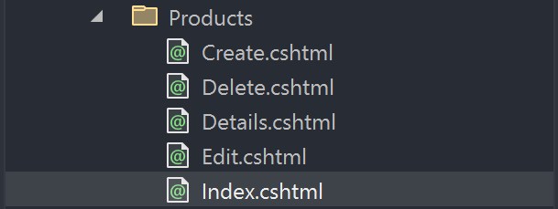
In the Products -> Index.cshtml page

Slide 62
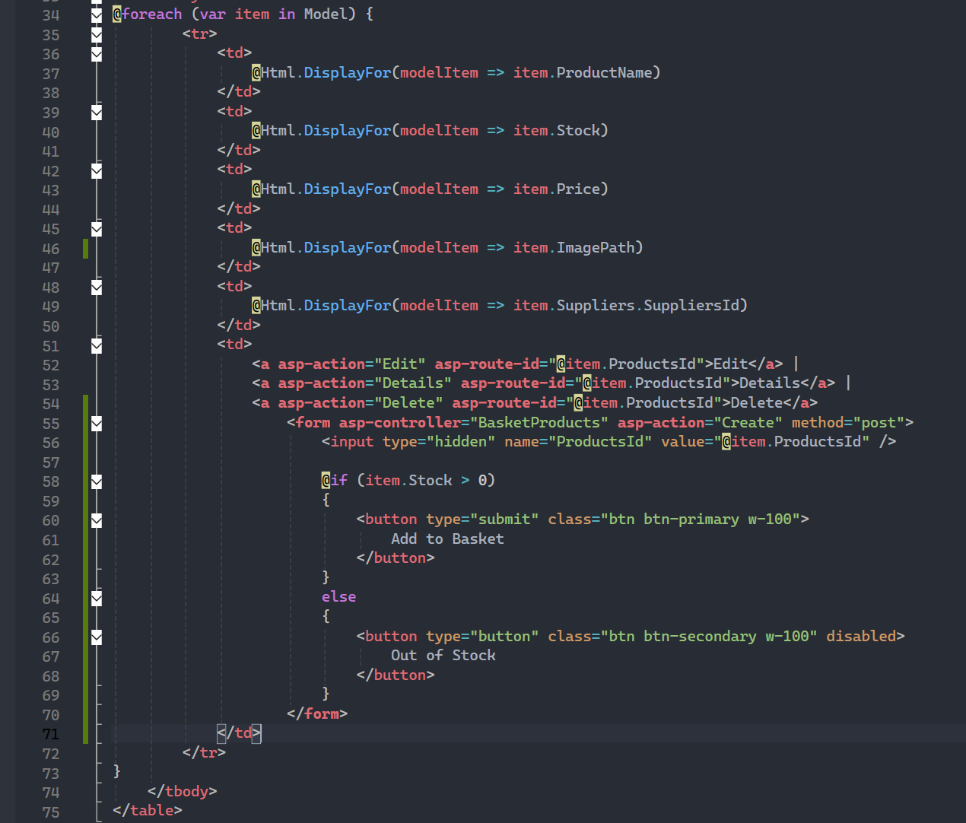
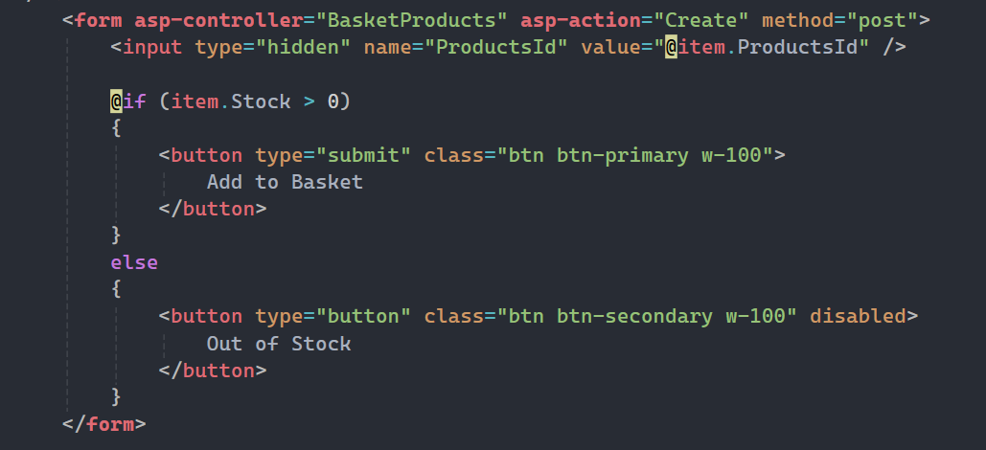
Add the "Add to Basket" Form
This should be how it looks in the file
This is the form code that you need to add

Slide 63

Should now have an Add to Basket button on each product if there is stock

Slide 64


Time to Edit the logic -> Go to the controller basketProducts and the POST Create function

Slide 65

First change -> Change the method so it only has one parameter

Slide 66

Now delete everything inside so it is an empty method body ready for new logic

Slide 67

First find the product they selected (Goes inside the empty Create Method)

Slide 68

Find the current logged in user

Slide 69

Find the current basket for that user, if no basket or no active basket then create a brand new one for the user

Slide 70

Now time to add the products to the basket
Find to see if the product is already in the basket.
If it is then increase the quantity by 1
If it is not then add the product ot the basket

Slide 71

Full Method Screenshot (Zoom where needed)

Slide 72

Try to add a product to the basket -> Should redirect you to the basket screen like this as long as you are logged in

Slide 73
Next Function -> Make the basket look better
Basket should display the user with the following information
Items in the basket
Cost of each item in the basket
Quantity of each item in the basket
Then the option to remove from basket
Option to checkout

Slide 74


BasketController Index Function

Slide 75

Start by finding the currently logged in user instead

Slide 76

Check if that user has a basket if not then create one for them

Slide 77

Next find all products in that basket and find the subtotal

Slide 78

Loyalty Discount Calc (Can add more conditions for different rewards)

Slide 79

Finally sending to the Viewbag and returning the view

Slide 80

Full new index method

Slide 81

Index.cshtml File in Baskets View

Slide 82
Change the model being passed through to this

Slide 83

Next Section

Slide 84
Next see if the basket is empty then display a message otherwise display the price and quantity of each item in the basket

Slide 85


Next see if the basket is empty then dispay a message otherwise display the price and quanity of each item in the absket

Slide 86

New Look Basket (Needs CSS Editing later)

Slide 87
Now to add the checkout functionality

Slide 88

First need to add the Checkout button
Add the circled code before continue shopping in the index.cshtml file we just changed for baskets

Slide 89


Orders Controller -> GET Method

Slide 90

Orders Views -> Create.cshtml

Slide 91

Delete all inside and replace

Slide 92

New Create Form

Slide 93

JavaScript to add at the bottom

Slide 94

Should now have a proceed to checkout button

Slide 95

When you click on it, should take you here

Slide 96
Time to get the Place Order button working

Slide 97


OrdersControllers Create Post

Slide 98

Delete main method body and change parameters

Slide 99

Inside the method first step -> Find currently logged n user and assign values for the order for that user

Slide 100

Next set the order date

Slide 101

Next set the order tracking status to pending by default to start with

Slide 102

Next finding all items in the basket

Slide 103

Subtotal Calculator section next

Slide 104

Discount Calculator

Slide 105

Handling Delivery or Collections

Slide 106

Error Check

Slide 107

Making the order and updating stock

Slide 108


Full Code (Zoom as required)

Slide 109

Should now be able to checkout -> Can see if it worked by going to order page

Slide 110
Next Feature -> Edit Order Index so it shows orders and then when click on details it shows a breakdown of products in the orders

Slide 111


Change Orders->Details.cshtml page

Slide 112

Change Orders Details get Controller Method

Slide 113

When you click details now

Slide 114
User should only see their own order history no one else's

Slide 115

OrdersControllers -> IndexMethod

Slide 116

OrdersControllers -> Index Method

Slide 117
Should now only see the current users order history

Slide 118
However Admin users should see all orders and then Suppliers should see all of their orders

Slide 119

Transform the OrdersController Index Method

Slide 120
Now have a much better viewing order system

Slide 121
Next Core Feature -> Supplier Dashboard

Slide 122
Can do this in many ways
Can do it using ViewData
Can do it using ViewModels
Going to use ViewData

Slide 123

Create a new controller

Slide 124

Choose the empty one

Slide 125

Name the Controller called SupplierDashboardController

Slide 126


Now Right Click the Views Folder and add a new folder called SupplierDashboard

Slide 127



Add an Index.cshtml view to that new folder

Slide 128
Back to the supplier Dashboard Controller

Slide 129

Authorise the whole controller for supplier role (Can add admin and dev later)

Slide 130

Add the _context and the controller

Slide 131

Now edit the index method to look like this

Slide 132


Go to the SupplierDashboard Views Folder and edit the index view

Slide 133

Should now have a supplier Dashboard

Slide 134
Time to add some management buttons to this page
Needs to be able to manage stock levels
See all their products not just first five
Update Product Details
View all Orders

Slide 135
Doesn't need to be all new pages just add buttons and maybe edit some existing pages

Slide 136
Supplier dashboard to view all orders

Slide 137
Add the button to take them to the Orders Index page which is already filtered for that supplier
Add to the bottom of the index.cshtml page

Slide 138

Now can manage all orders by clicking that and then I can edit and so on

Slide 139
To update product details need to view all of their products only and then the edit functionality is already there

Slide 140
Add the button before the orders and after the products in the SupplierDashboard INdex.cshtml page

Slide 141

Edit the ProductsController Index endpoint method

Slide 142

Index Endpoint should look like this

Slide 143

Now can see the button to view all products

Slide 144

From here can click edit and can edit and update product details

Slide 145

Lets quickly fix the edit option as first those buttons for edit and delete should only be viewable if you are a supplier

Slide 146


Edit so it now looks like this with the if statement

Slide 147

Now go to the edit.cshtml page

Slide 148


Remove the SuppliersId Section so it is hidden instead

Slide 149

Now go to the Products Controller Edit Get Method

Slide 150

Can remove this line

Slide 151
Remove SuppliersId from the Bind here in the post method

Slide 152

Add this to the top of the post method

Slide 153

Full Post Edit Method

Slide 154
Can now edit only those products

Slide 155
Do the same for Deleting the Products

Slide 156
Next Feature -> Update Tracking Status

Slide 157
This is simply just allowing us to UPDATE the one field in the orders which exists alreayd
Can already view all orders from dashboard
Need to edit the update so there are set options to choose from

Slide 158

Edit.cshtml in the Orders View folder

Slide 159

Change the highlighted section

Slide 160

Should now look like this

Slide 161
Can now do all of these
Needs to be able to manage stock levels
See all their products not just first five
Update Product Details
View all Orders
Need to remove all of the user Id's and foreign keys from all forms and .cshtml files and then match up accordingly in the back end
Got to add authorisation to the methods for multiple roles
Need to add the GMAIL Login system
Need to add CSS
User views their past orders
Loyalty scheme
FAQ
Recipes
Search bar

Slide 162
What is left to complete?
Need to remove all of the user Id's and foreign keys from all forms and .cshtml files and then match up accordingly in the back end
Got to add authorisation to the methods for multiple roles
Need to add the GMAIL Login system
Need to add CSS

